Slide 1

Group 6: House Hunters
Ben Bowling
Corine Daboiko
Lakshmi Bhimavarapu
Sarah Beck
Zemi Moore

Slide 2
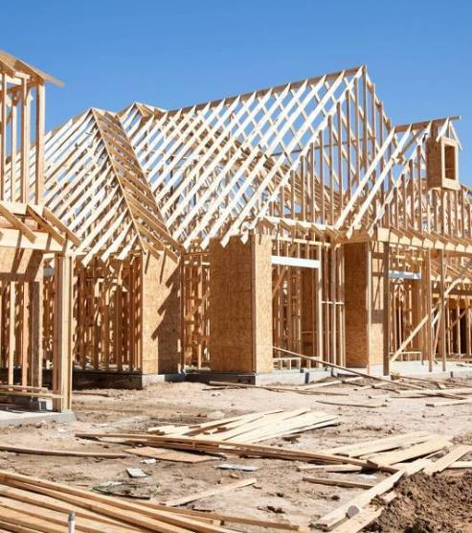

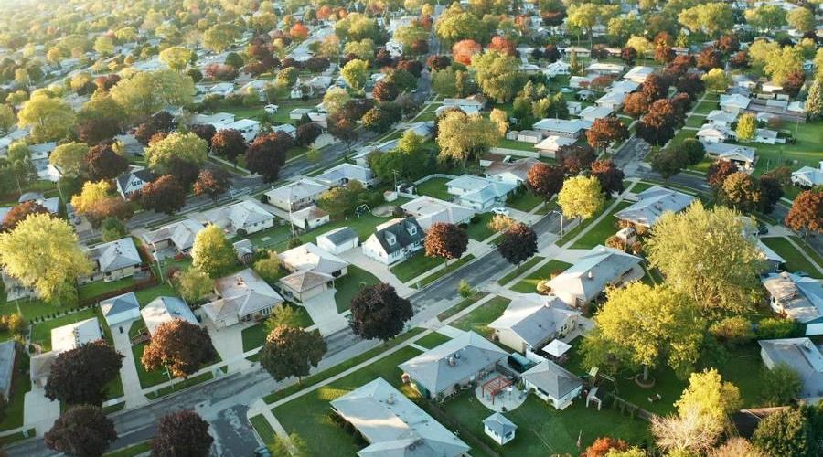
Theme and Data Prep/Cleaning
This project seeks to better understand what affects the affordability of homes in states of the US that interest us as a group.

Slide 3
Flowchart
EDA
Analyze the 3 attributes that affect the price of homes by state
Raw data
(from kaggle)
Identify pertinent data
&
Clean the data
Slice and Dice the data to analyze in multiple ways
Identify least priced homes in each state
Analyze the average of the attributes that affect the sale price by state/territory

Slide 4




BASED ON THIS DATA, WHICH ATTRIBUTE (NUMBER OF BEDROOMS/BATHS, SQUARE FOOTAGE) MOST AFFECTS THE SELLING PRICE OF A HOME?
Notes:
Question: WHICH ATTRIBUTE (NUMBER OF BEDROOMS/BATHS, SQUARE FOOTAGE) MOST AFFECTS THE SELLING PRICE OF A HOME?
Hypotheses:
1-The higher the house size, the more expensive the house is.
2- The number of bedrooms does not result in the lower house price.
3- The number of bathrooms results in a higher house price.

Slide 5
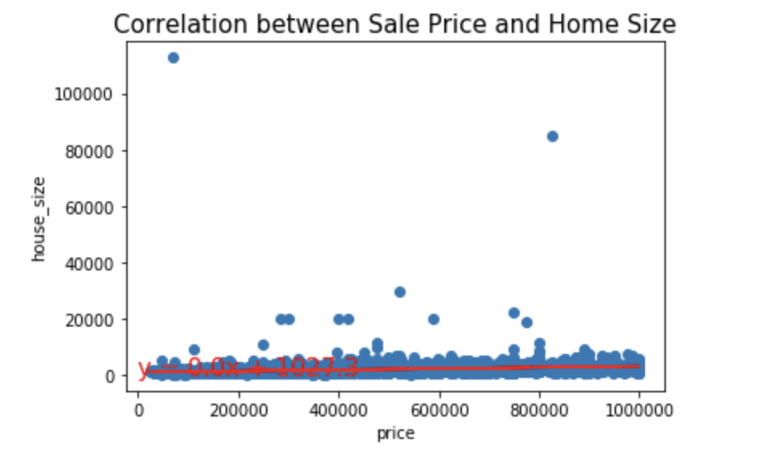
Relationship between Price & the Home Size
Dropped outliers for sale price above $1,000,000
Used scatter plot to find out how is the data distributed
Find correlation : r -value = 0.057
Notes:
The correlation coefficient was chosen to help us compare, and find the attribute that has a strong positive linear correlation.
Not a strong correlation between the house size and the price

Slide 6
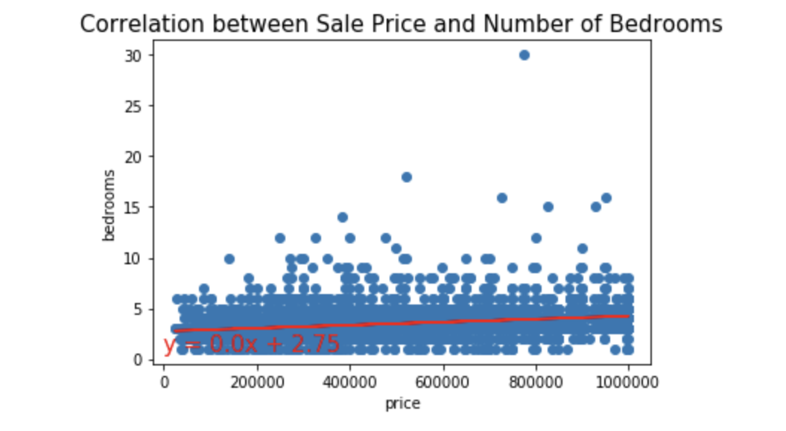
Relationship between Price & the Number of Bedrooms
Dropped outliers for sale price above $1,000,000
Used scatter plot to find out how is the data distributed
Find correlation : r -value = 0.078
Notes:
The correlation coefficient was chosen to help us compare, and find the attribute that has a strong positive linear correlation.
closer to 1 but still not as strong correlation between the number of bedrooms and the price

Slide 7
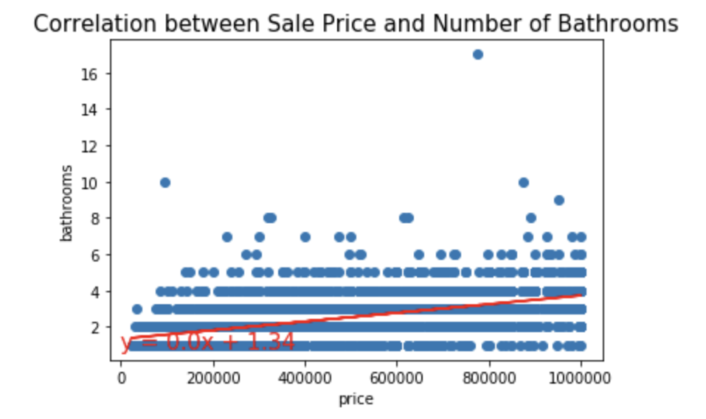
Relationship between Price & the Number of Bathrooms
Dropped outliers for sale price above $1,000,000
Used scatter plot to find out how is the data distributed
Find correlation : r -value = 0.29
Notes:
The correlation coefficient was chosen to help us compare, and find the attribute that has a strong positive linear correlation.
Strongest correlation between x & y variables , price & number of bathrooms
Conclusion - The greater the number of bathrooms, the more expensive the house is.

Slide 8
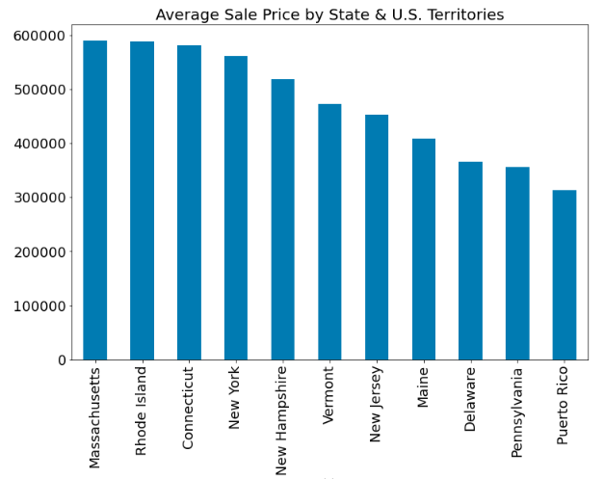
What is the average sales price for each state and how does the number of rooms compare to the sales price for that state?
Average sale prices
Massachusetts ($589,880)
Rhode Island ($587,449)
Pennsylvania ($356,104)
Puerto Rico ($313,148)
Notes:
.

Slide 9
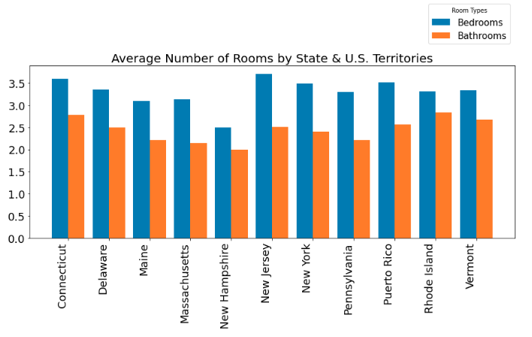
What is the average sales price for each state and how does the number of rooms compare to the sales price for that state? (cont.)
Highest Average for Bedrooms
New Jersey (3.7)
Connecticut (3.6)
Highest Average for Bathrooms
Rhode Island (2.8)
Connecticut (2.7)
Notes:
.

Slide 10
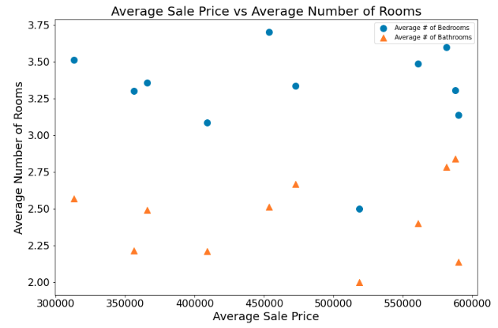
What is the average sales price for each state and how does the number of rooms compare to the sales price for that state? (cont.)
Averages remained consistent
Average number of bedrooms
3.4
Average number of bathrooms
2.4
Notes:
.

Slide 11
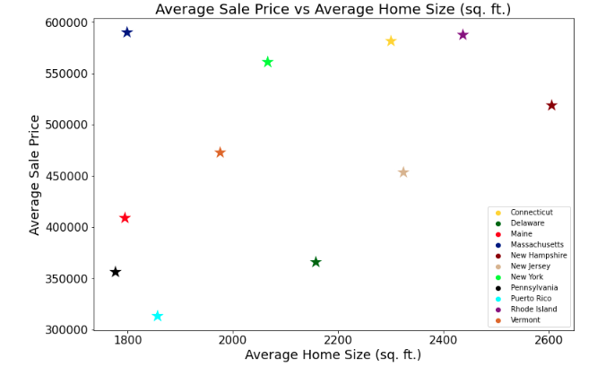
For the all states, how does the average home size impact the average sale price per state?
Best state to live based on the home size is price would be New Jersey ($453,337 & 2,323 square foot)
Outlier: Lowest square footage with the highest purchase price - Massachusetts ($589,880 & 1,799 Square foot)
The larger the home, the higher the purchase price
The correlation between the average home size and the average sale price is: 0.45
Notes:
.

Slide 12
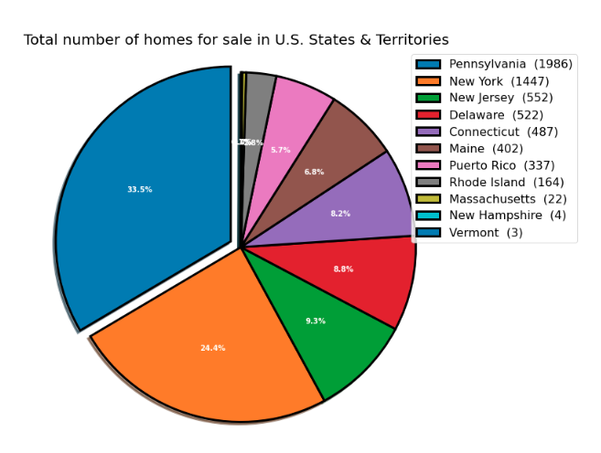
For the state of Pennsylvania, how does the home size impact the selling price for that state and what is the correlation?
Total number of U.S States & Territories (11)
Total number of homes (5,926)
Pennsylvania (1,986) 33.5%
Notes:
.

Slide 13
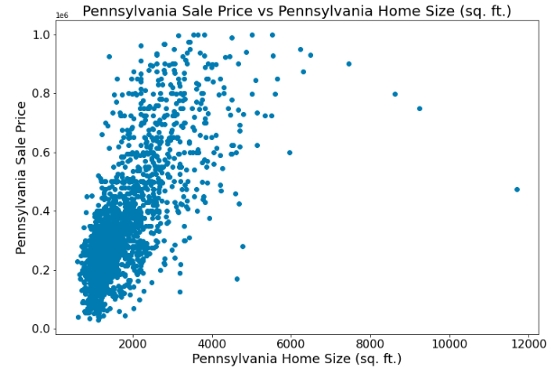

For the state of Pennsylvania, how does the home size impact the selling price for that state and what is the correlation?
Pennsylvania sample size (1,986 homes)
Larger sq ft, higher sales price
3 outliers listed below
Notes:
.

Slide 14
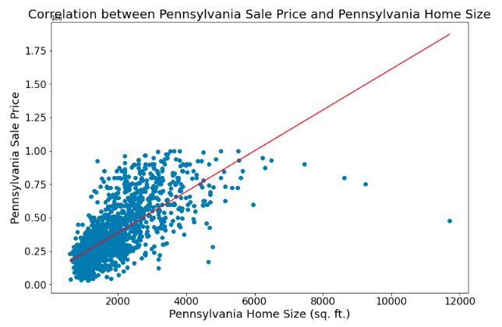
For the state of Pennsylvania, how does the home size impact the selling price for that state and what is the correlation?
Positive correlation (0.70)
Larger sq ft, higher sales price
Notes:
.

Slide 15
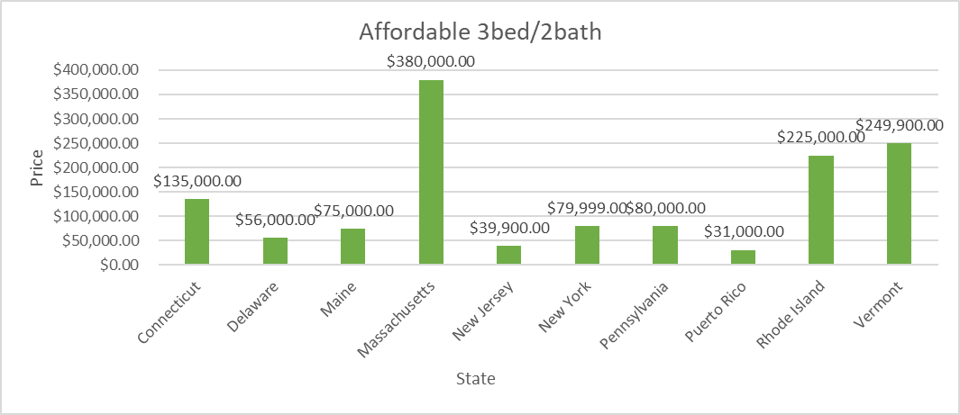
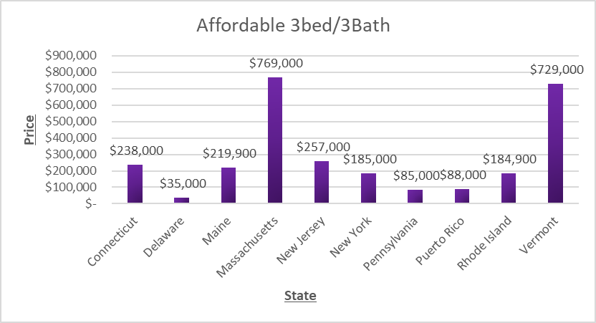
Which state has the most affordable 3 bedroom 2 bath home?

Slide 16
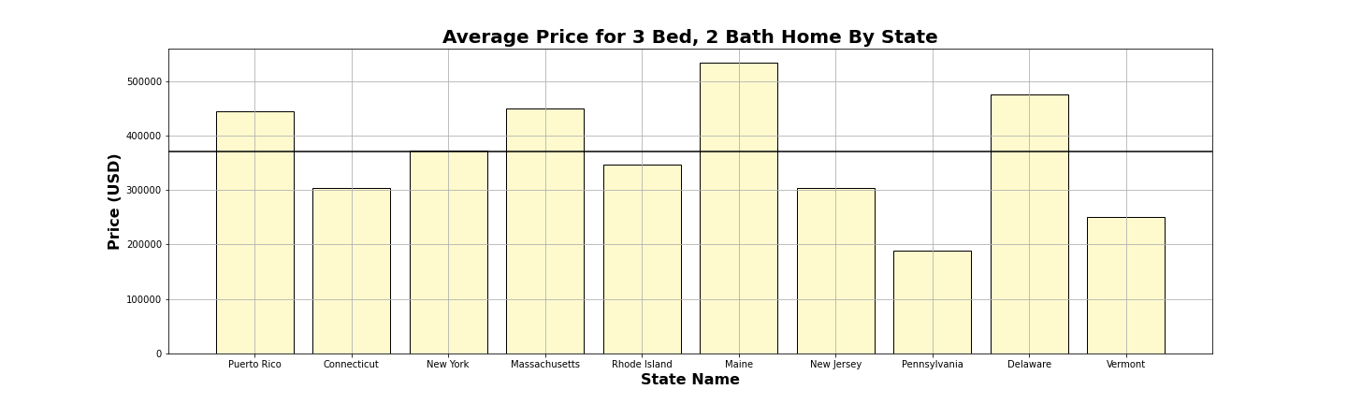
Average Cost of Home By State
According to US Census data, the average home has 3 bedrooms and 2 bathrooms
Outliers: Vermont & Massachusetts
H-Line at $370,397

Slide 17
Group 6: House Hunters
Ben Bowling
Corine Daboiko
Lakshmi Bhimavarapu
Sarah Beck
Zemi Moore

